Slide 1
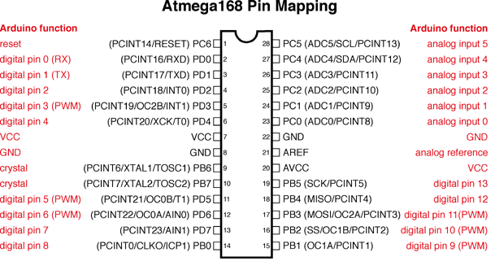
Pin mapping ATMega328P to Arduino

Slide 2
Arduino – Lighting LEDs
Bare Metal Coding
Normal
#include "Arduino.h"
void setup() { // setting PB5 or pin13 as output
DDRB = B00100000;
}
void loop() {
PORTB = B00100000; // Write HIGH to PB5
delay(1000);
PORTB = B00000000; // Write LOW to PB5
delay(1000);
}
NOTE: Output = 1, Input = 0;
#include “Arduino.h”
void setup() {
pinMode(13, OUTPUT);
}
void loop() {
digitalWrite(13, HIGH);
delay(1000);
digitalWrite(13, LOW);
delay(1000);
}

Slide 3
Interrupts

Slide 4
Interrupts
Bare Metal Coding
Normal
#include <avr/io.h>
#include <avr/interrupt.h>
static volatile int onOff=0;
void setup() {
cli(); // Disable interrupts
EICRA |= 0b00000011; //INT0 respond on the RISING edge
DDRB |= 0b00010000;
EIMSK |= 0b00000001; // Activate INT0
sei(); // Enable interrupts
}
ISR(INT0_vect) {
onOff=1-onOff;
}
void loop(void) {
if(onOff==0)
PORTB &=0b11101111;
else
PORTB |= 0b00010000;
}
#define LEDPIN 12
static volatile int onOff = 0;
//volatile: variable read straight from memory and not stored in a storage register
//static: value only accessible in a single file
void switchISR() {
onOff = 1 - onOff;
}
void setup() {
attachInterrupt(digitalPinToInterrupt(2), switchISR, RISING);
pinMode(LEDPIN, OUTPUT);
}
void loop() {
if(onOff == 0)
digitalWrite(LEDPIN, LOW);
else
digitalWrite(LEDPIN, HIGH);
}
note: INT0 is digital pin 2
INT1 is digital pin 3

Slide 5
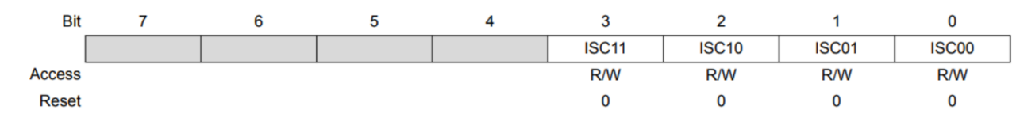
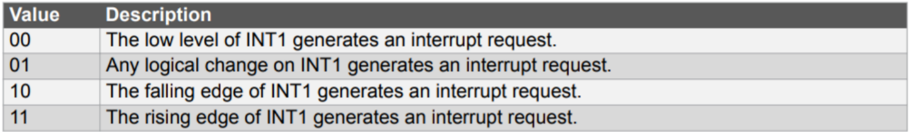
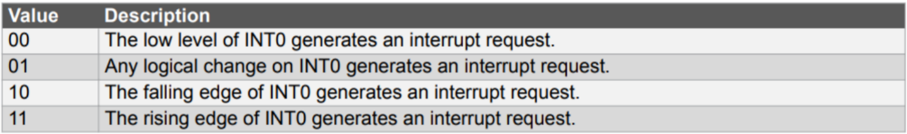

EICRA – External Interrupt Control Register A
EICRA
Interrupt Sense Control (ISC)
ISC1n
ISC0n
1 to turn interrupt on
EIMSK – External Interrupt Mask Register

Slide 6
Interrupt PWM Wave Generation
#include "Arduino.h"
#include <avr/io.h>
#include <avr/interrupt.h>
void setup() {
TCNT0 = 0;
OCR0A = 0;
TCCR0A = 0b10000001;
TIMSK0 |= 0b10;
TCCR0B = 0b00000011; //always last step: starts the clock
sei();
}
ISR(TIMER0_COMPA_vect) {
OCR0A = 25;
}
void loop() {
DDRD |= (1 << DDD6); //set PD6 or OC0A as output
while (1) { }
}

Slide 7
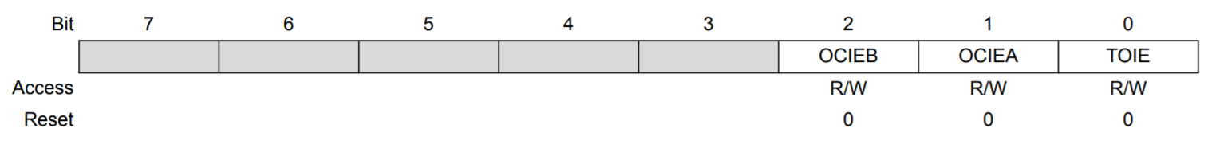
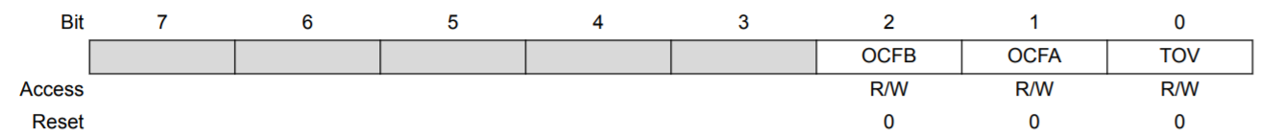
TIMSK & OCR
TIMSKn – Timer Interrupt Mask Register
Enable TIMERn to generate interrupts when TCNTn reaches OCRnx
OCIE: Output compare interrupt enable
OCRnx – Output compare register
OCR0A, OCR0B; OCR2A, OCR2B; etc.
When TCNTn reaches OCRnx, will output OCnx
TIFRn – Timer interrupt flag register
Only if you don’t want to use interrupts
Flag is 1 when timer interrupt is triggered (TCNTn = OCRnA/B)
TIMSK0
TIFRn

Slide 8
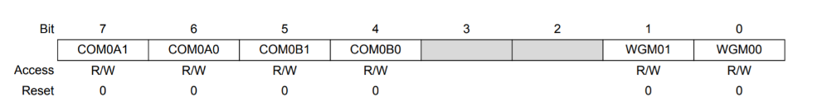
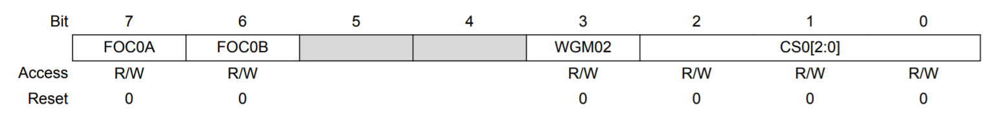
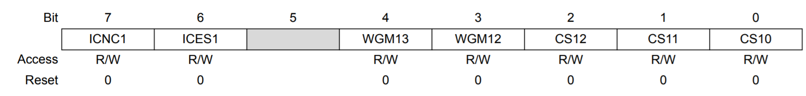
TCCRnA & TCCRnB
TCCRnA
TCCR0B
TCCR1B
TCCR0A
TCCR0A
CS: Clock scalar
TCCR0B
TCCR1B

Slide 9
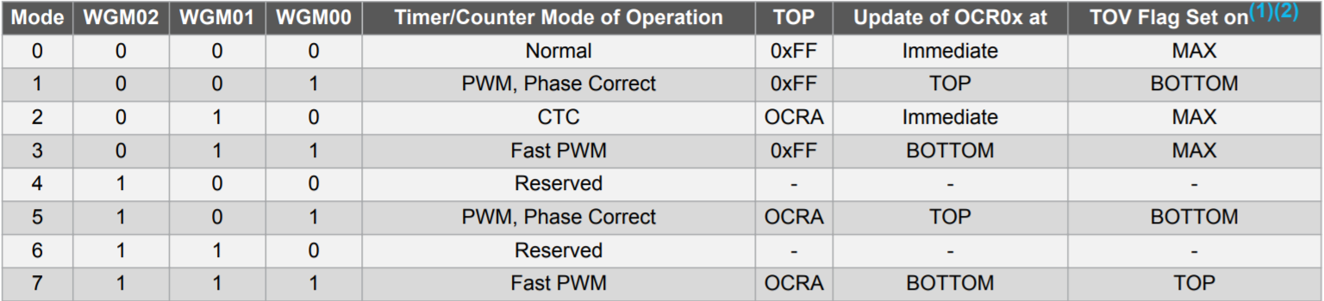
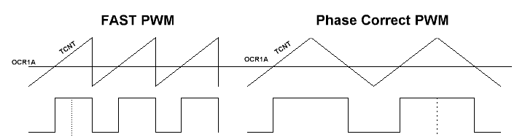
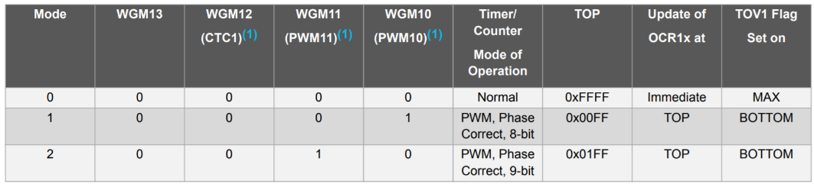
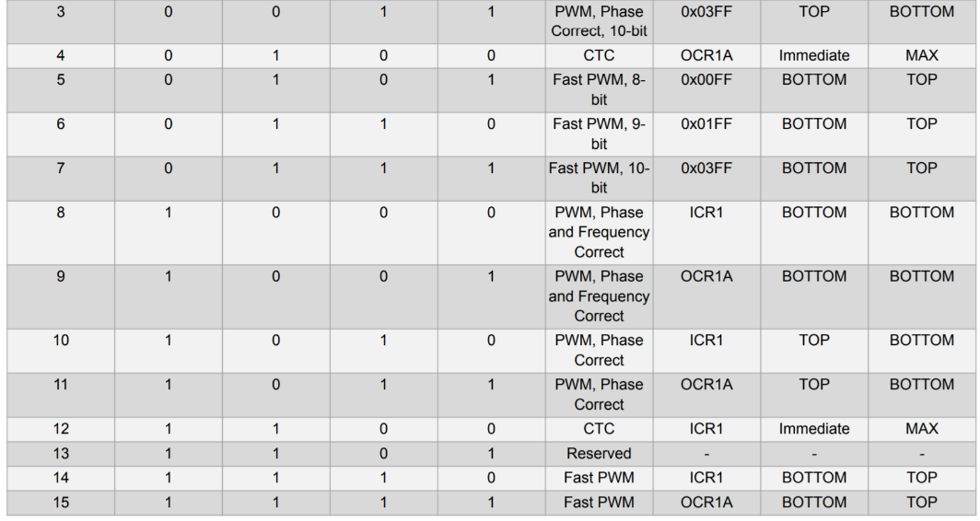
Waveform Generation Modes
Waveform Generation Mode, Timer 0 & 2
Waveform Generation Mode, Timer1
period: set by prescalar CS
Duty cycle: set by OCR
Timer 0, 2 – holds up to 8 bits
Timer 1 – can hold up to 16 bits

Slide 10
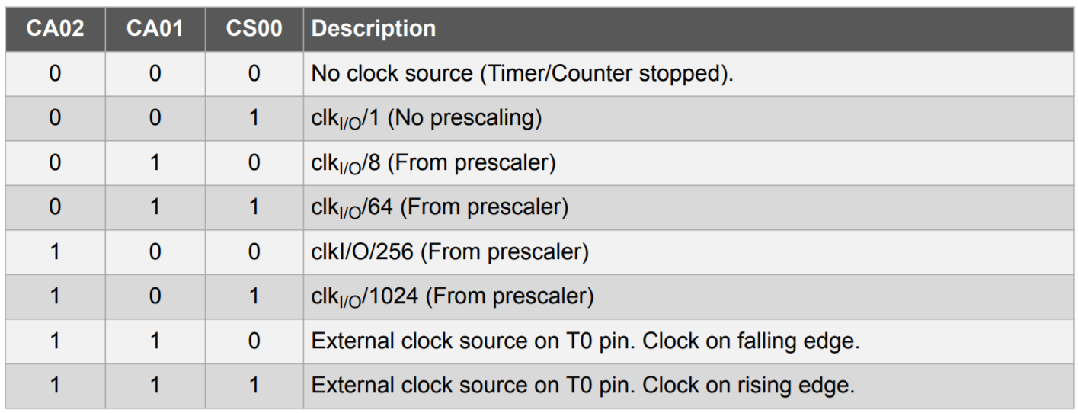
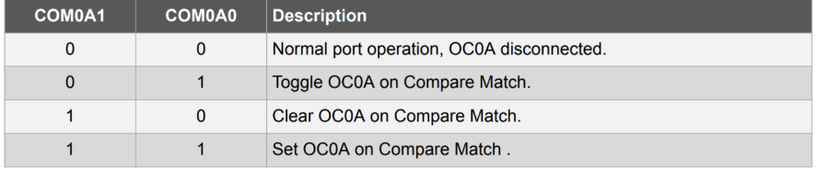

Clock Scalar & Compare Match
Setting clock frequency (CS)
Compare match
Choosing prescalar: $N=\frac{f_{clk}}{510 ∗f_{PWM}}$
Choosing OCR0A based on desired duty cycle
Duty cycle $=\frac{OCR0A}{255} ∗100$

Slide 11

CTC – Clear Timer on Comapre
TCNTn clears to 0 when OCRnA (V-1) is reached, triggers timer interrupt
Timer resolution = $\frac{f_{clock}}{prescalar}$
Top timer value, V $=\frac{T_{cycle}}{timer res}$
Always choose the smallest prescalar value = largest V that fits into 8/16-bit register
For the best resolution
NOTE
8 bits: max value 255
16 bits: max value 65535

Slide 12
Interrupt Timers – Useful for generating diff clock cycles
#include <avr/io.h>
#include <avr/interrupt.h>
#define F_CPU 16000000UL
#include <util/delay.h>
//delay() depends on TIMER0;
//use these two LoC to enable _delay_ms
#define LED__delay_ms 100
static volatile int turn=0;
static volatile unsigned long _timerTicks = 0;
ISR(TIMER1_COMPA_vect) {
_timerTicks++;
if (_timerTicks==5) {
turn = 1-turn;
_timerTicks=0;
}
}
void flashGreen() {
PORTB |= 0b00010000;
_delay_ms(LED__delay_ms);
PORTB &= 0b11101111;
_delay_ms(LED__delay_ms);
}
void flashRed() {
PORTB |= 0b00001000;
_delay_ms(LED__delay_ms);
PORTB &= 0b11110111;
_delay_ms(LED__delay_ms);
}
void setupTimer() {
cli();
TCCR1A = 0;
TCCR1B = 0; //to make sure clock hasn’t started
TIMSK1 = 0b10;
TCNT1 = 0;
OCR1A = 62499;
}
void startTimer() { TCCR1B = 0b01100; } //set to CTC mode
void setup() { //increasing timer period
DDRB |= 0b00011000;
setupTimer();
startTimer();
sei();
}
void loop() {
if(turn==0)
flashGreen();
else
flashRed();
}

Slide 13
Debouncing
#define THRESHOLD 100
unsigned long lastTime = 0, currTime;
ISR(INT0_vect) {
currTime = millis();
if (currTime – lastTime > THRESHOLD) {
lastTime = currTime;
//do stuff
}
}

Slide 14
Other
Sorting, Git, others

Slide 15
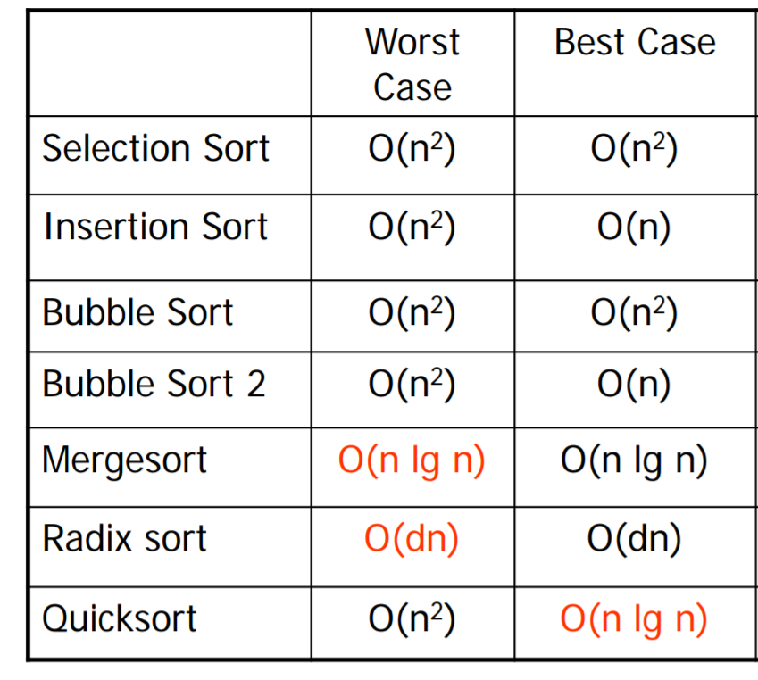
Pi components: a miniature PC. Processor, RAM, secondary (persistent) storage
How interrupts are processed
Interrupt detected, get ISR address, push PC to stack, execute ISR, pop PC from stack
PC: program counter; so that code can resume from where it was left off after interrupt
Interrupt priority: the lower the address, the higher the priority

